Slide 1
SECURE DATA HIDING IN IMAGES USING STEGANOGRAPHY
SECURE THE DATA TO PREVENT HACKERS
Presented By:
Student Name : ROHIT J
College Name & Department : S.A.ENGINEERING COLLEGE & CSE

Slide 2
OUTLINE
Problem Statement
Technology used
Wow factor
End users
Result
Conclusion
Git-hub Link
Future scope

Slide 3
Problem Statement
With the increasing need for data security, ensuring safe storage and transmission of sensitive information is crucial. Traditional encryption techniques often make messages visibly encrypted, attracting attention. This project aims to hide encrypted text inside an image, providing a covert way to store and transmit secret messages securely.

Slide 4
Technology used
Programming Language: Python
Libraries: OpenCV, NumPy
Encryption Algorithm: XOR Cipher
Image Processing: Pixel Manipulation using OpenCV

Slide 5
Wow factors
Steganography Approach: Instead of sending an encrypted message separately, the data is embedded within an image.
Lightweight Encryption: Uses XOR cipher, which is simple yet effective for basic security.
Lossless Data Storage: Uses a PNG format to ensure pixel accuracy and prevent data corruption.

Slide 6
End users
Security Enthusiasts: Individuals interested in cryptography and steganography.
Journalists & Whistleblowers: Need secure ways to send confidential information.
Students & Researchers: Exploring encryption and image processing techniques.

Slide 7
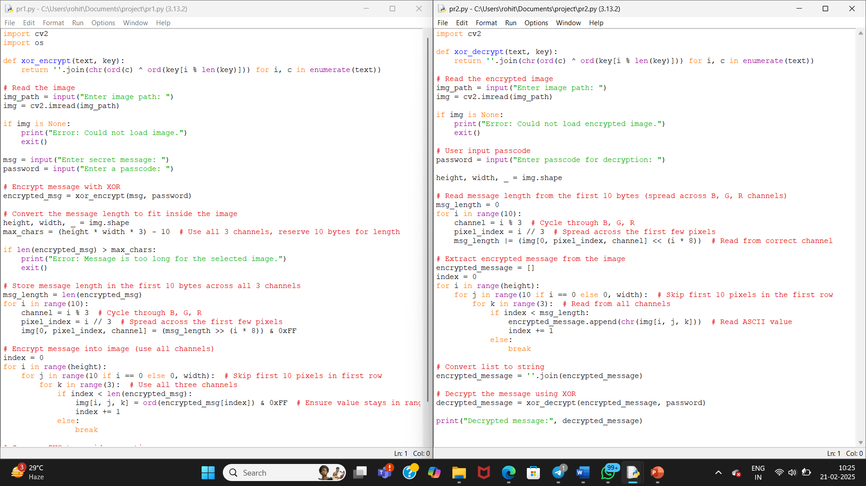
Results

Slide 8
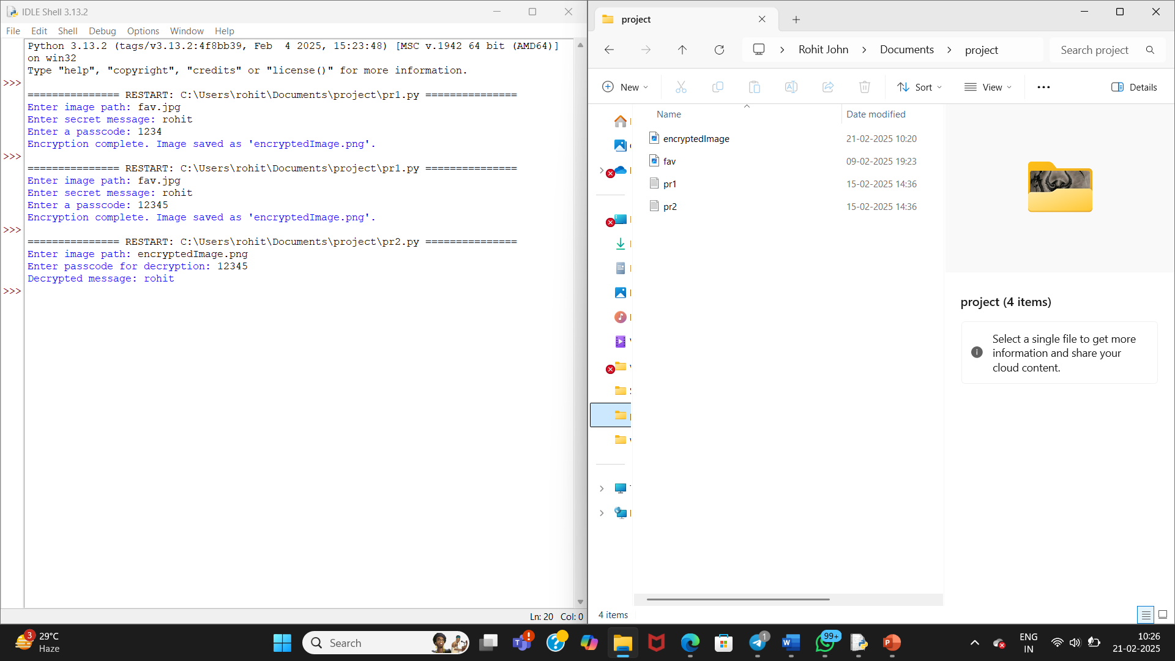

Slide 9
Conclusion
This project demonstrates a simple yet effective way to hide encrypted messages within images using pixel manipulation. It serves as an introduction to image steganography and basic encryption, showcasing how security can be integrated into multimedia files.

Slide 10
GitHub Link
https://github.com/RJ6803/SECURE_DATA_HIDING_IN_IMAGES_USING_STEGANOGRAPHY.git

Slide 11
THANK YOU

